Slide 1
Waterway-sunrise-i_657B

Slide 2
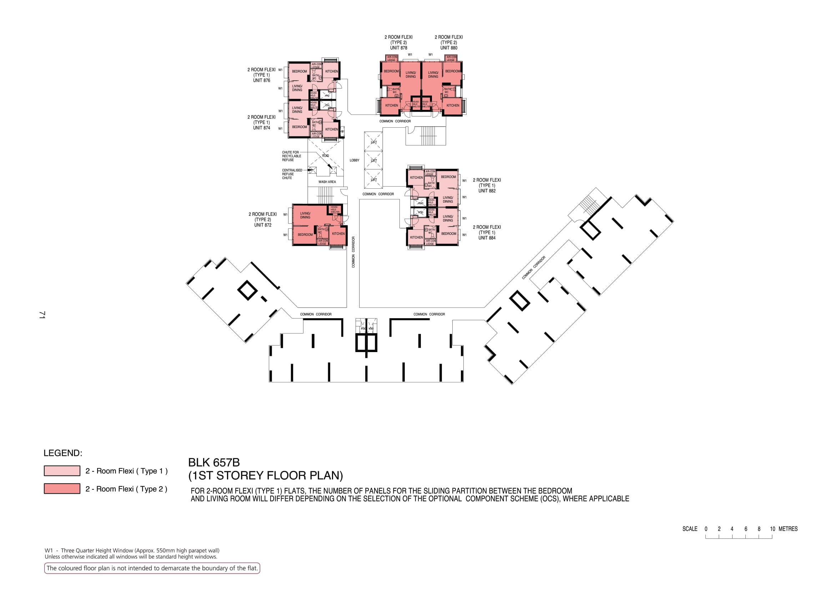

Slide 3
876
878
880
874
COMMON CORRIDOR
LOBBY
WASH AREA
COMMON CORRIDOR
882
872
884
COMMON CORRIDOR
COMMON CORRIDOR
COMMON CORRIDOR
COMMON CORRIDOR

Slide 4
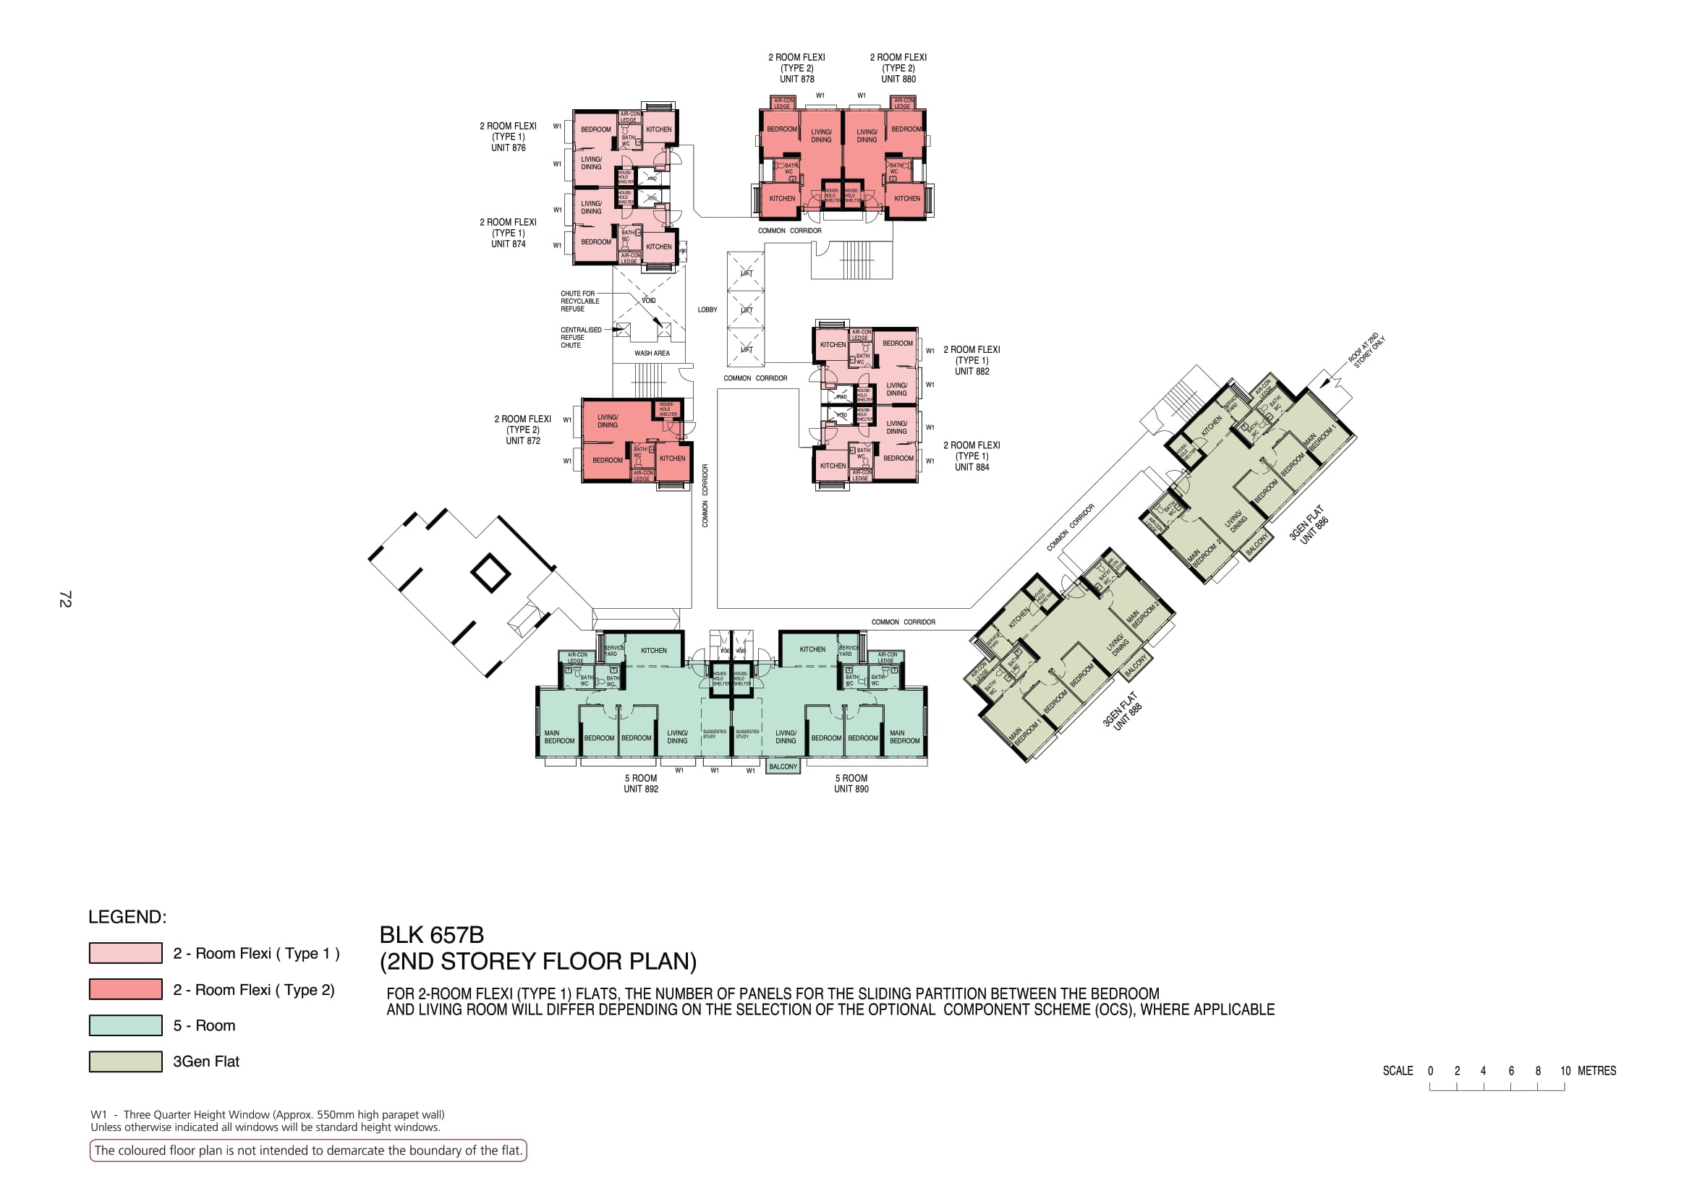

Slide 5
876
878
880
874
COMMON CORRIDOR
LOBBY
WASH AREA
COMMON CORRIDOR
882
872
884
886
COMMON CORRIDOR
COMMON CORRIDOR
COMMON CORRIDOR
COMMON CORRIDOR
888
892
890

Slide 6
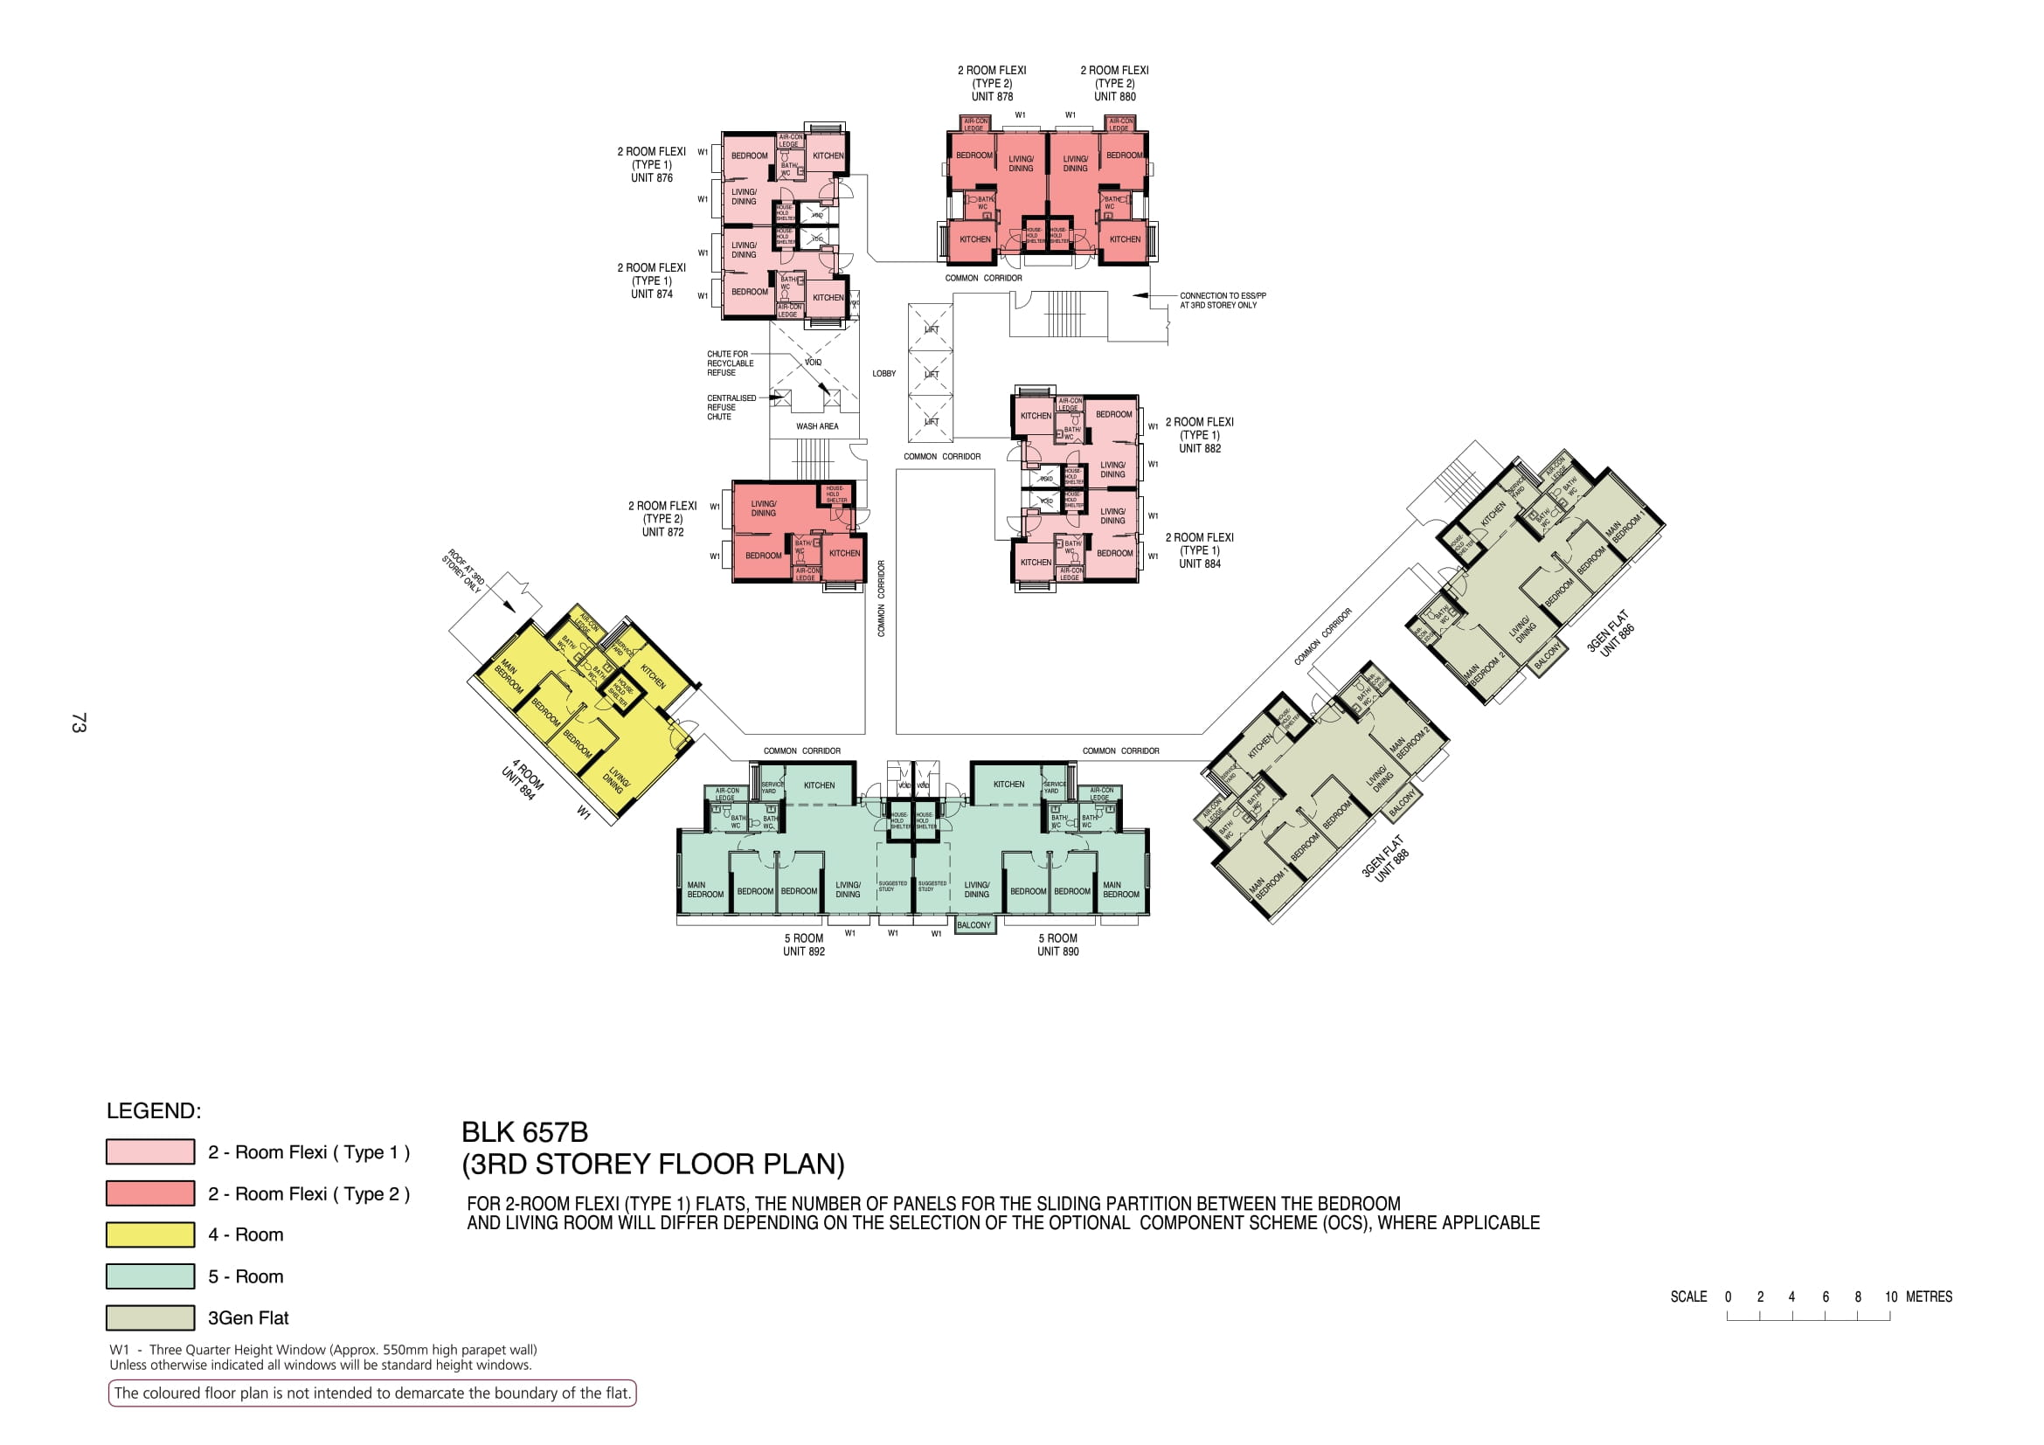

Slide 7
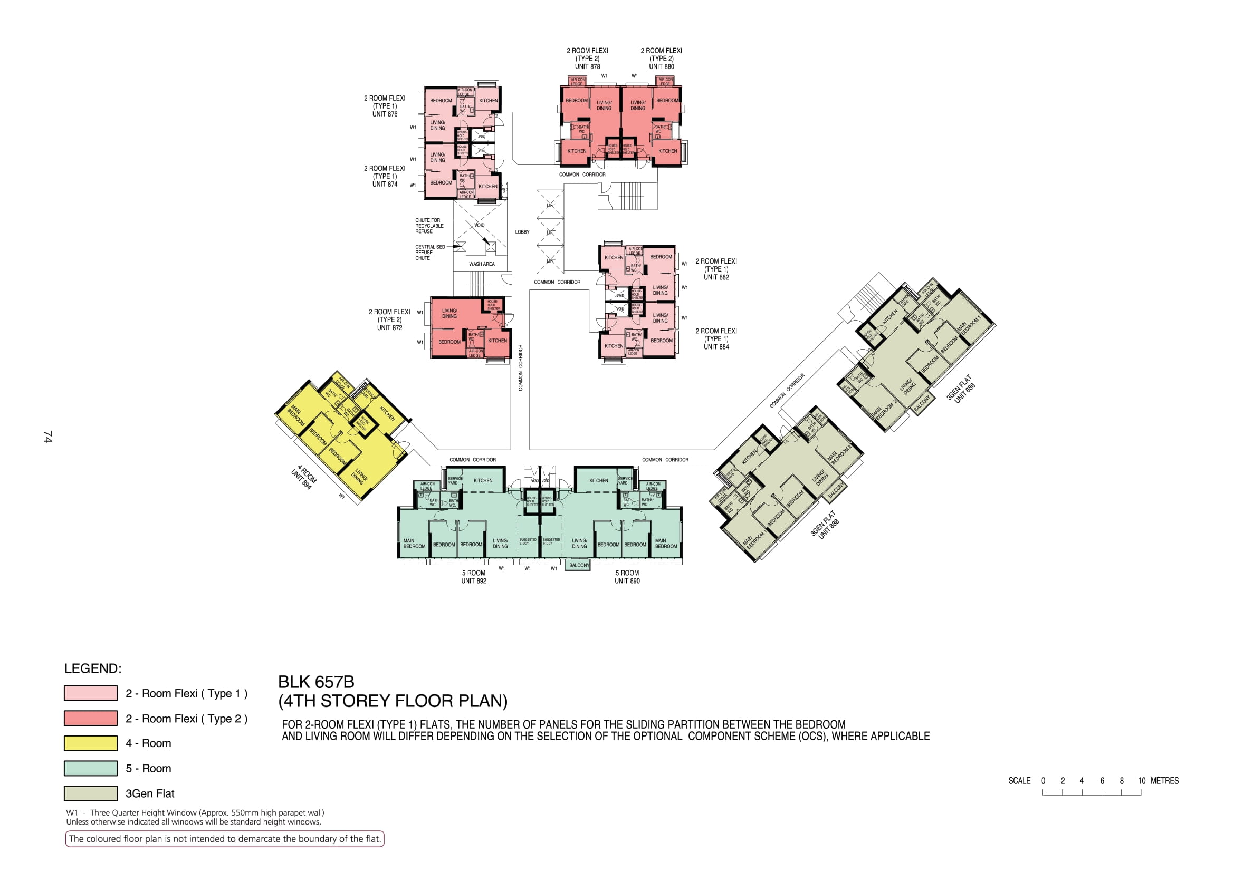

Slide 8
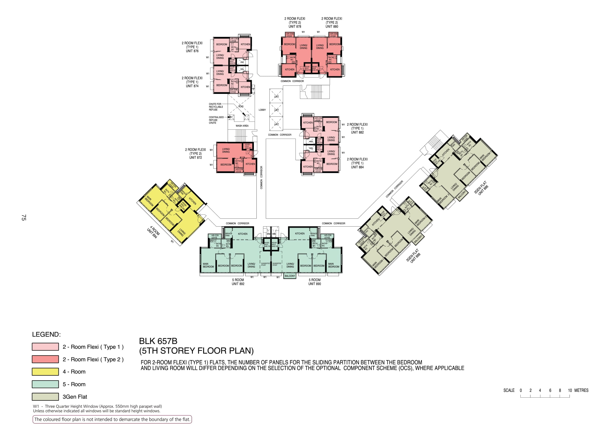

Slide 9
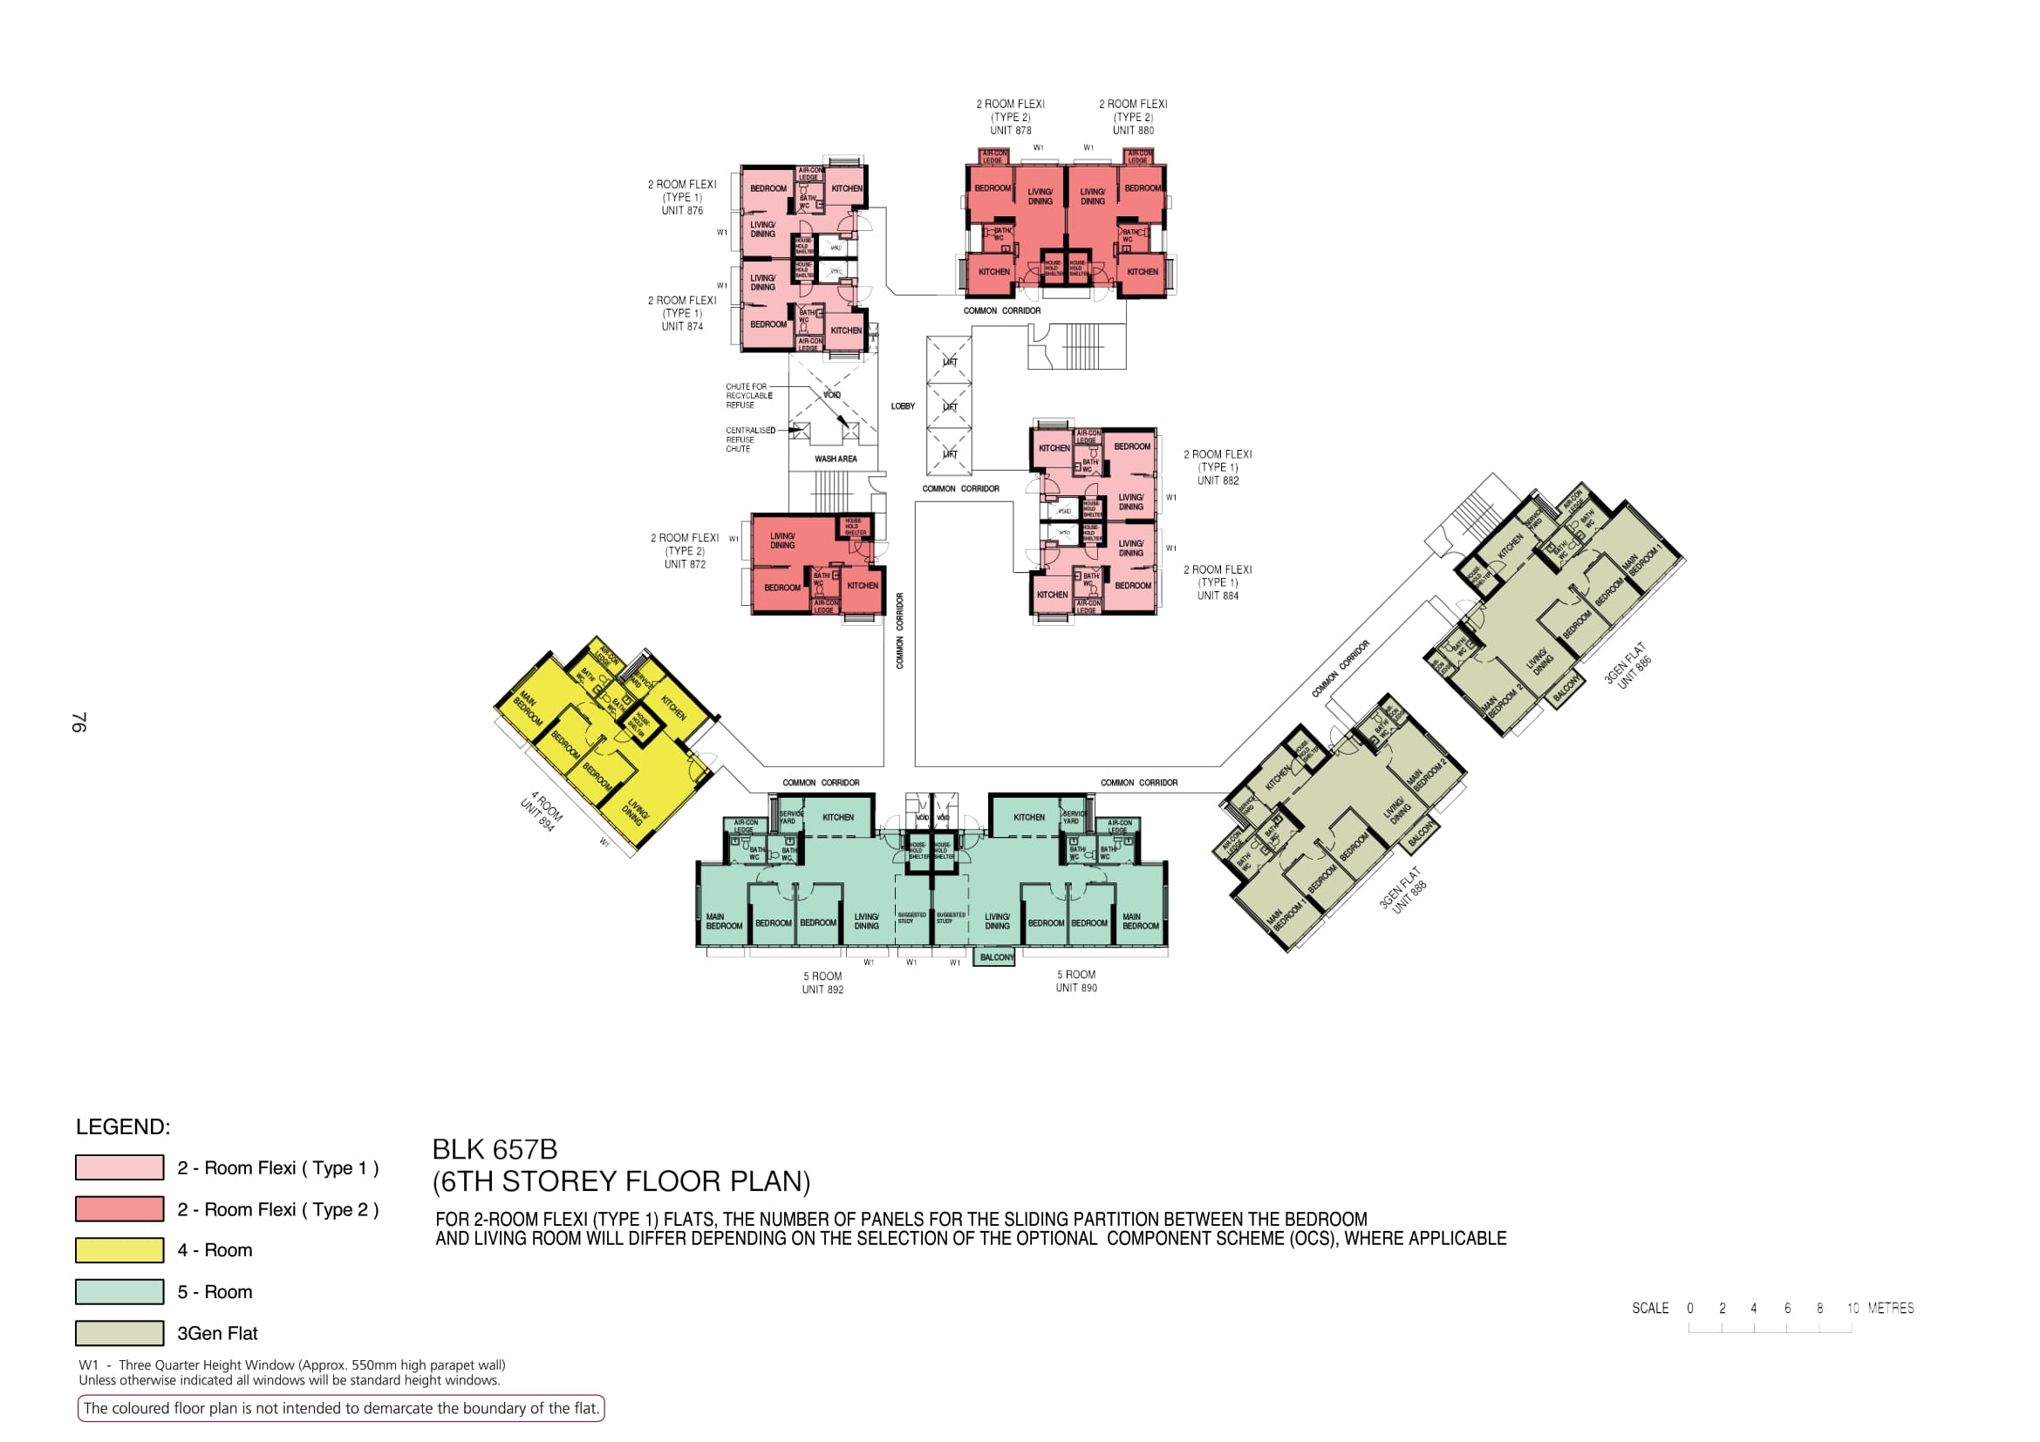

Slide 10
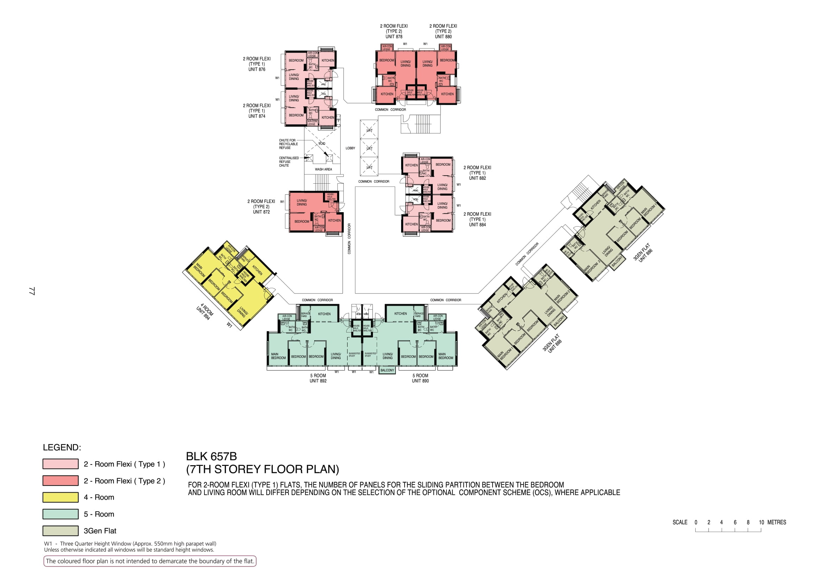

Slide 11
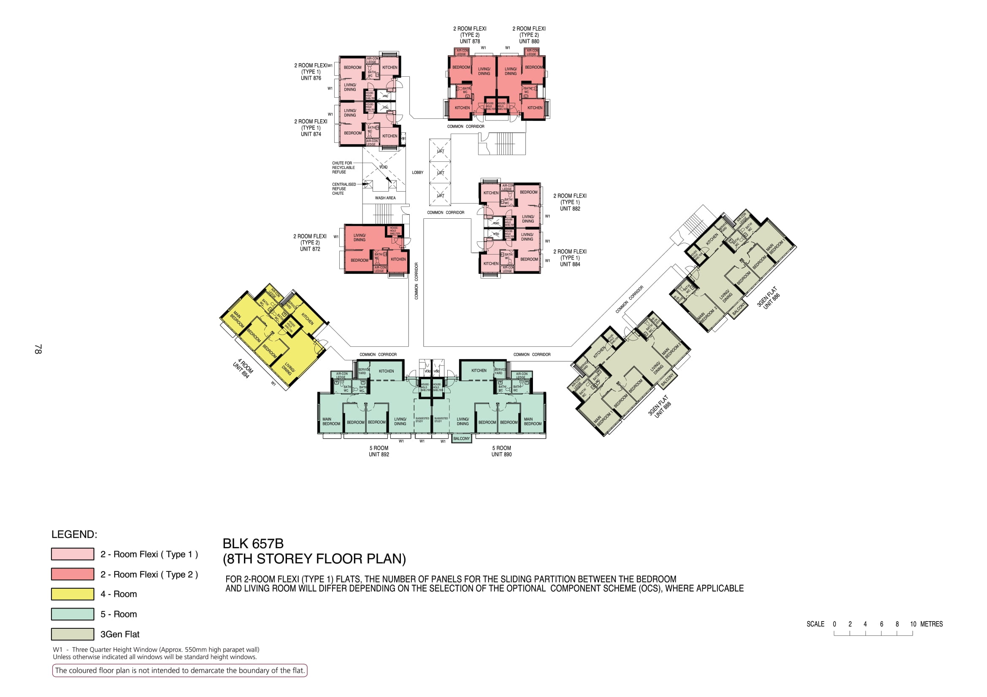

Slide 12
876
878
880
874
COMMON CORRIDOR
LOBBY
WASH AREA
COMMON CORRIDOR
882
872
884
886
COMMON CORRIDOR
COMMON CORRIDOR
894
COMMON CORRIDOR
COMMON CORRIDOR
888
892
890

Slide 13
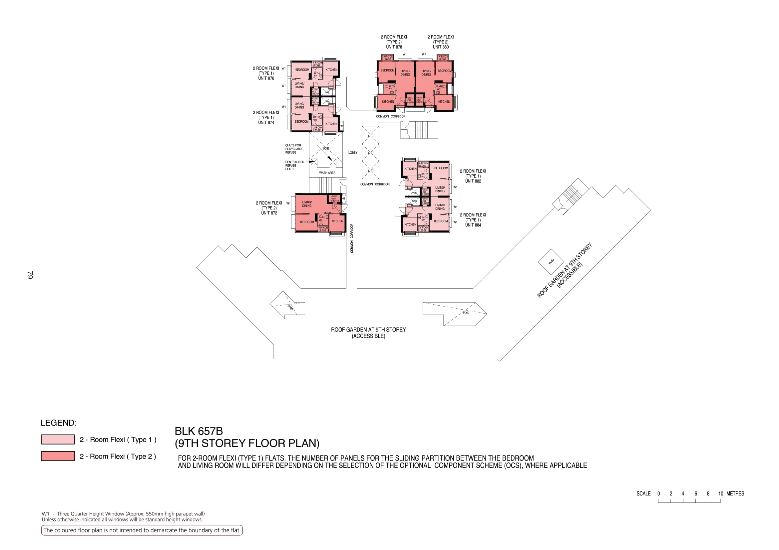

Slide 14
876
878
880
874
COMMON CORRIDOR
LOBBY
WASH AREA
COMMON CORRIDOR
882
872
884
COMMON CORRIDOR
ROOF GARDEN
ROOF GARDEN

Slide 15
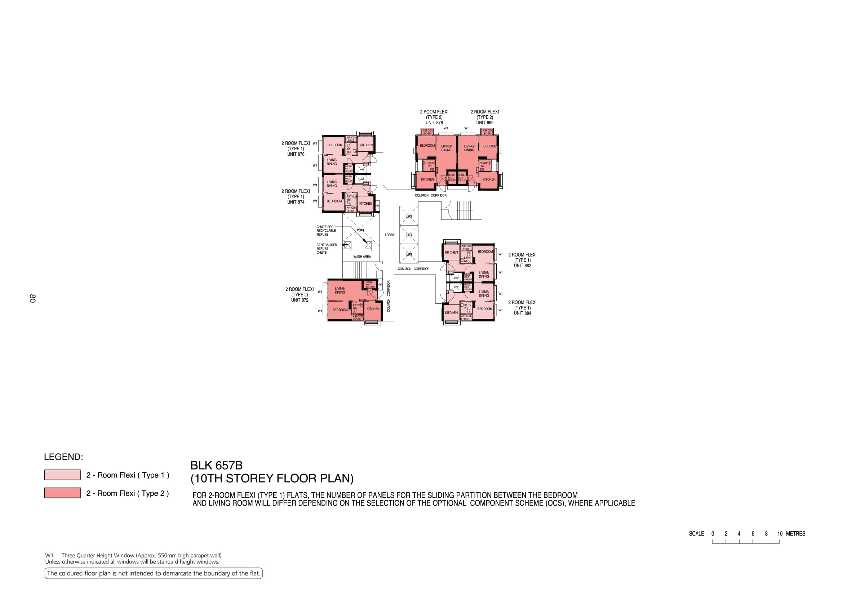

Slide 16
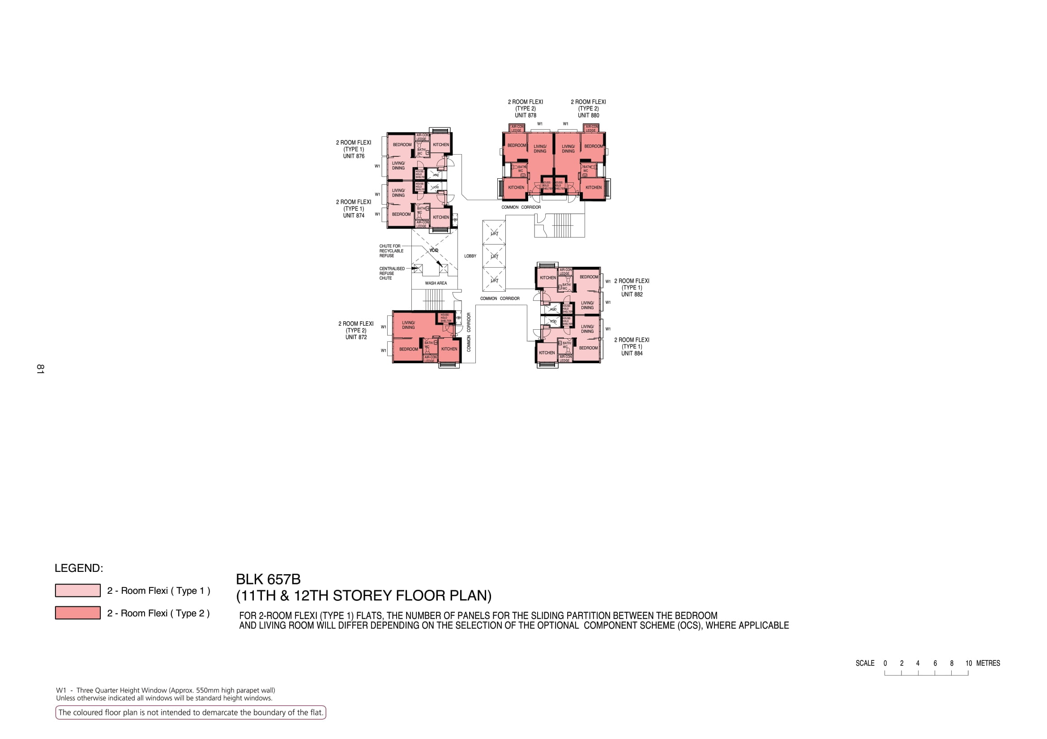

Slide 17
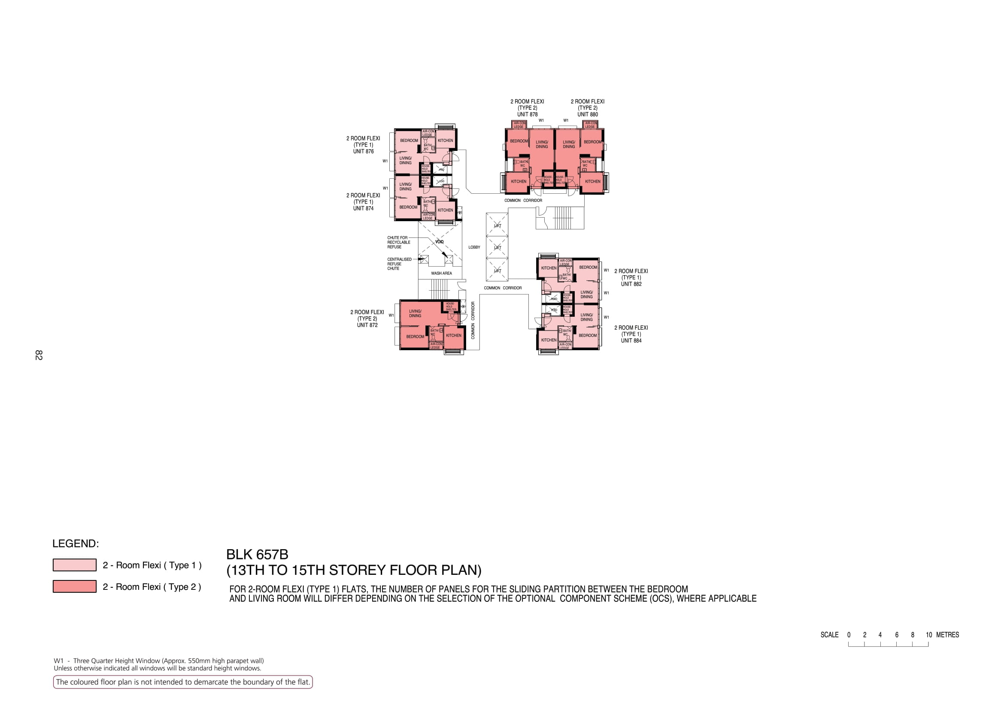

Slide 18
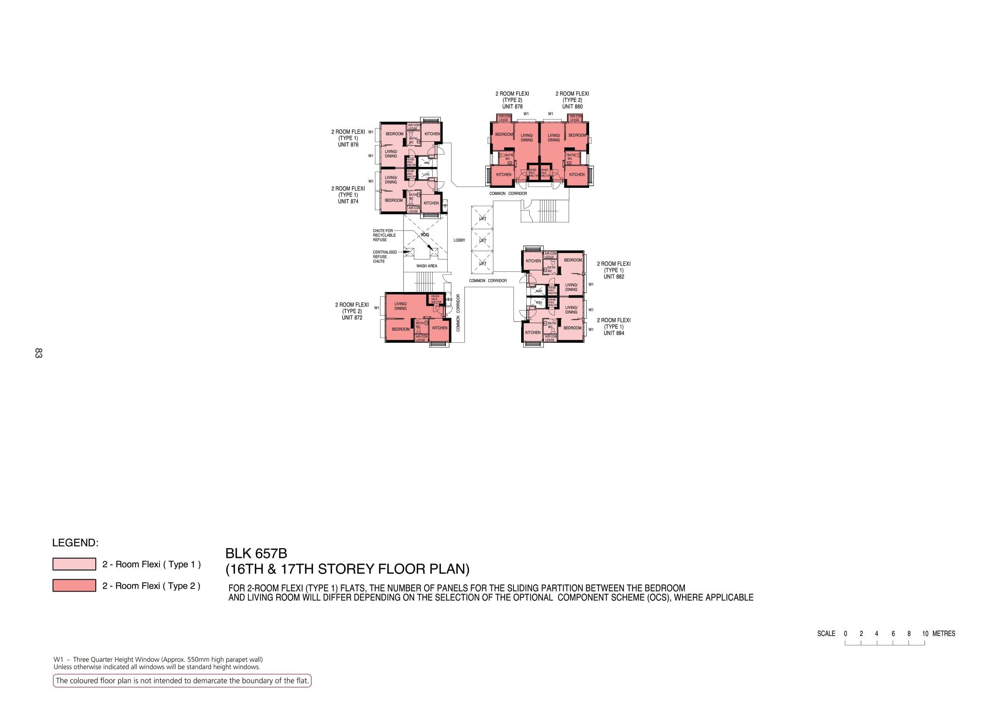

Slide 19
876
878
880
874
COMMON CORRIDOR
LOBBY
WASH AREA
882
COMMON CORRIDOR
872
COMMON CORRIDOR
884

